Slide 1
Key Takeaway Points
A software process defines the phases of activities or what need to be performed to construct a software system.
A software methodology details the steps or how to perform the activities of a software process. A methodology is an implementation of a process.
Software development needs a software process and a methodology.

Slide 2
Software Process
System development challenges call for an engineering approach for software development. A software process is required.
Definition 2.1 A software process defines a series of activities performed to construct a software system. Each activity produces some artifacts, which are the input to other phases. Each phase has a set of entrance criteria and a set of exit criteria.

Slide 3
The Waterfall Process
System Engineering
Software Requirements Analysis
Software Design
Coding & Unit Testing
Integration & Integration Testing
Acceptance Testing
Maintenance

Slide 4
Merits of the Waterfall Model
The simple, straight sequence of phases of the waterfall simplifies project management.
It supports function-oriented project organization:
  Each project is carried out by a pipeline of functional teams.
  Each functional team is specialized in one function such as requirements analysis, design, implementation, integration and testing, and so forth.

Slide 5
Problems of the Waterfall Model
It is inflexible to requirements change.
The long development duration means the system is outdated when it is delivered.
Users cannot experiment with the system to provide early feedback.
The customer has to wait until the entire system is implemented and deployed to reap the benefits.
The customer may lose the entire investment if the project fails.

Slide 6
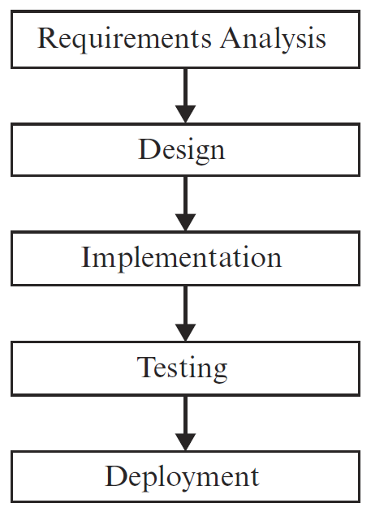
Agile Process Models
phases in an iteration
Iterations

Slide 7
Scrum
Unique key features:
  include Scrum Master, Product Owner, and Team roles
  15 minute daily status meeting to improve communication
  team retrospect to improve process

Slide 8
Scrum Lifecycle Activities
Release planning meeting
  identify and prioritize requirements, called product backlog
  identify top priority requirements to be delivered within an increment, called a sprint
  identify sprint development activities
Sprint iteration
  sprint planning meeting to determine what and how to build next
  daily Scrum meeting to exchange status
Sprint review meeting
  increment demo
  team retrospection
Deployment

Slide 9


Scrum Process
Daily Scrum Meeting
Release Planning
Sprint Planning
2-4 Weeks
Sprint Retrospection
Potentially Shippable Product Increment
Product Backlog
Sprint Backlog

